Slide 1
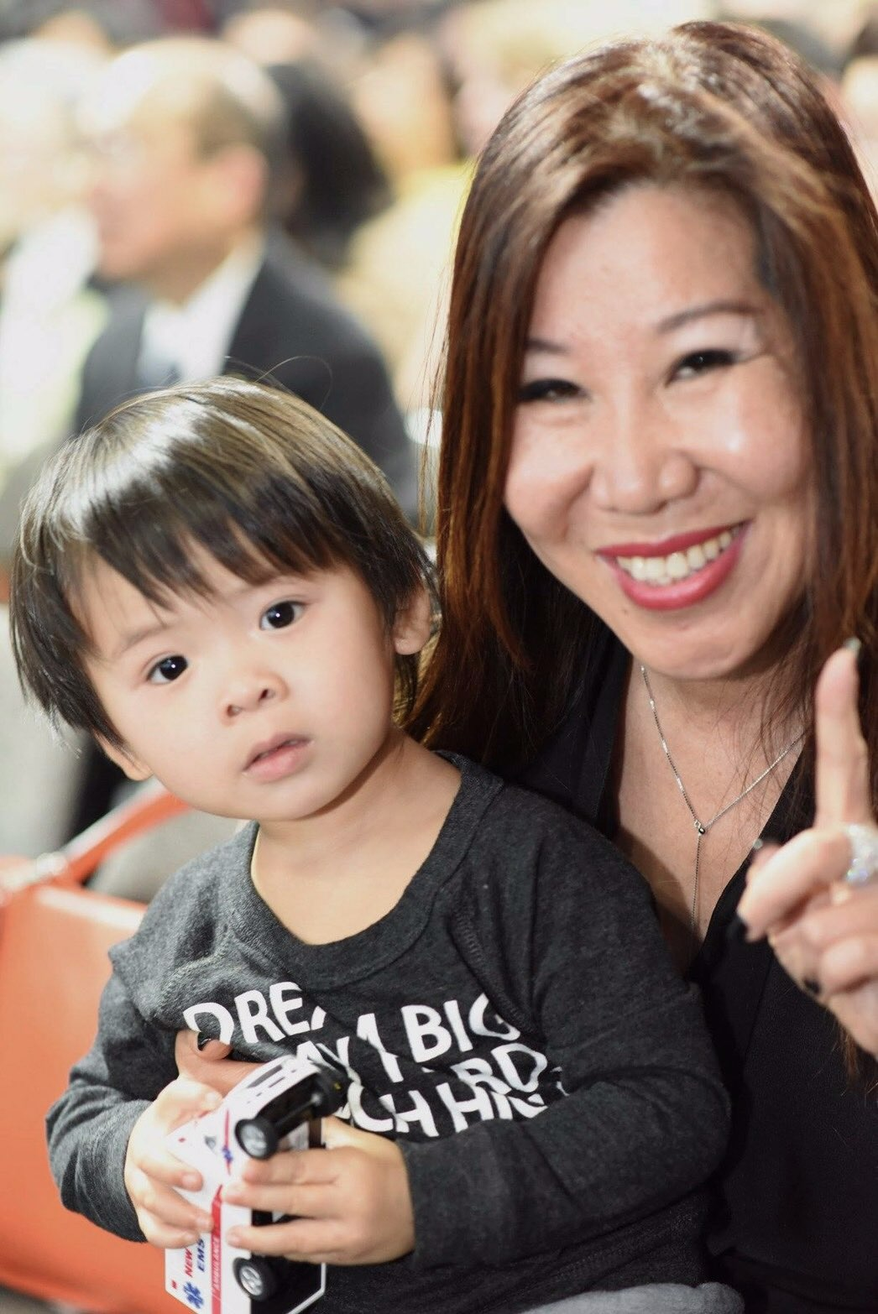
International Field Chairman
four-week pay cycle
US$125,000 - US$149,000
(4,000,000)
Joanne Hsi (席再凤)
THE INCOME LEVELS MENTIONED IN THIS PRESENTATION ARE FOR ILLUSTRATION PURPOSES ONLY. THEY ARE NOT INTENDED TO REPRESENT THE INCOME OF ANY TYPICAL MARKET SINGAPORE ® UNFRANCHISE® OWNER, NOR ARE THEY INTENDED TO REPRESENT THAT ANY GIVEN UNFRANCHISE® OWNER WILL EARN INCOME IN THAT AMOUNT.
THE SUCCESS OF ANY MARKET SINGAPORE ® UNFRANCHISE® OWNER WILL DEPEND UPON THE AMOUNT OF HARD WORK, TALENT, AND DEDICATION WHICH HE OR SHE DEVOTES TO BUILDING HIS OR HER MARKET SINGAPORE® BUSINESS.

Slide 2
Self introduction
Born in a military family (foreigner)
Got married after college graduation.
Never had any work experience
Got divorced in 1987 and raised my son by myself
Immigrated to the United States in 1990.
Knew little English and had no job
Joined Market America in December, 1995

Slide 3
Characteristic
Humble
Diligent
Enduring
Communication
Praise
Integrity

Slide 4
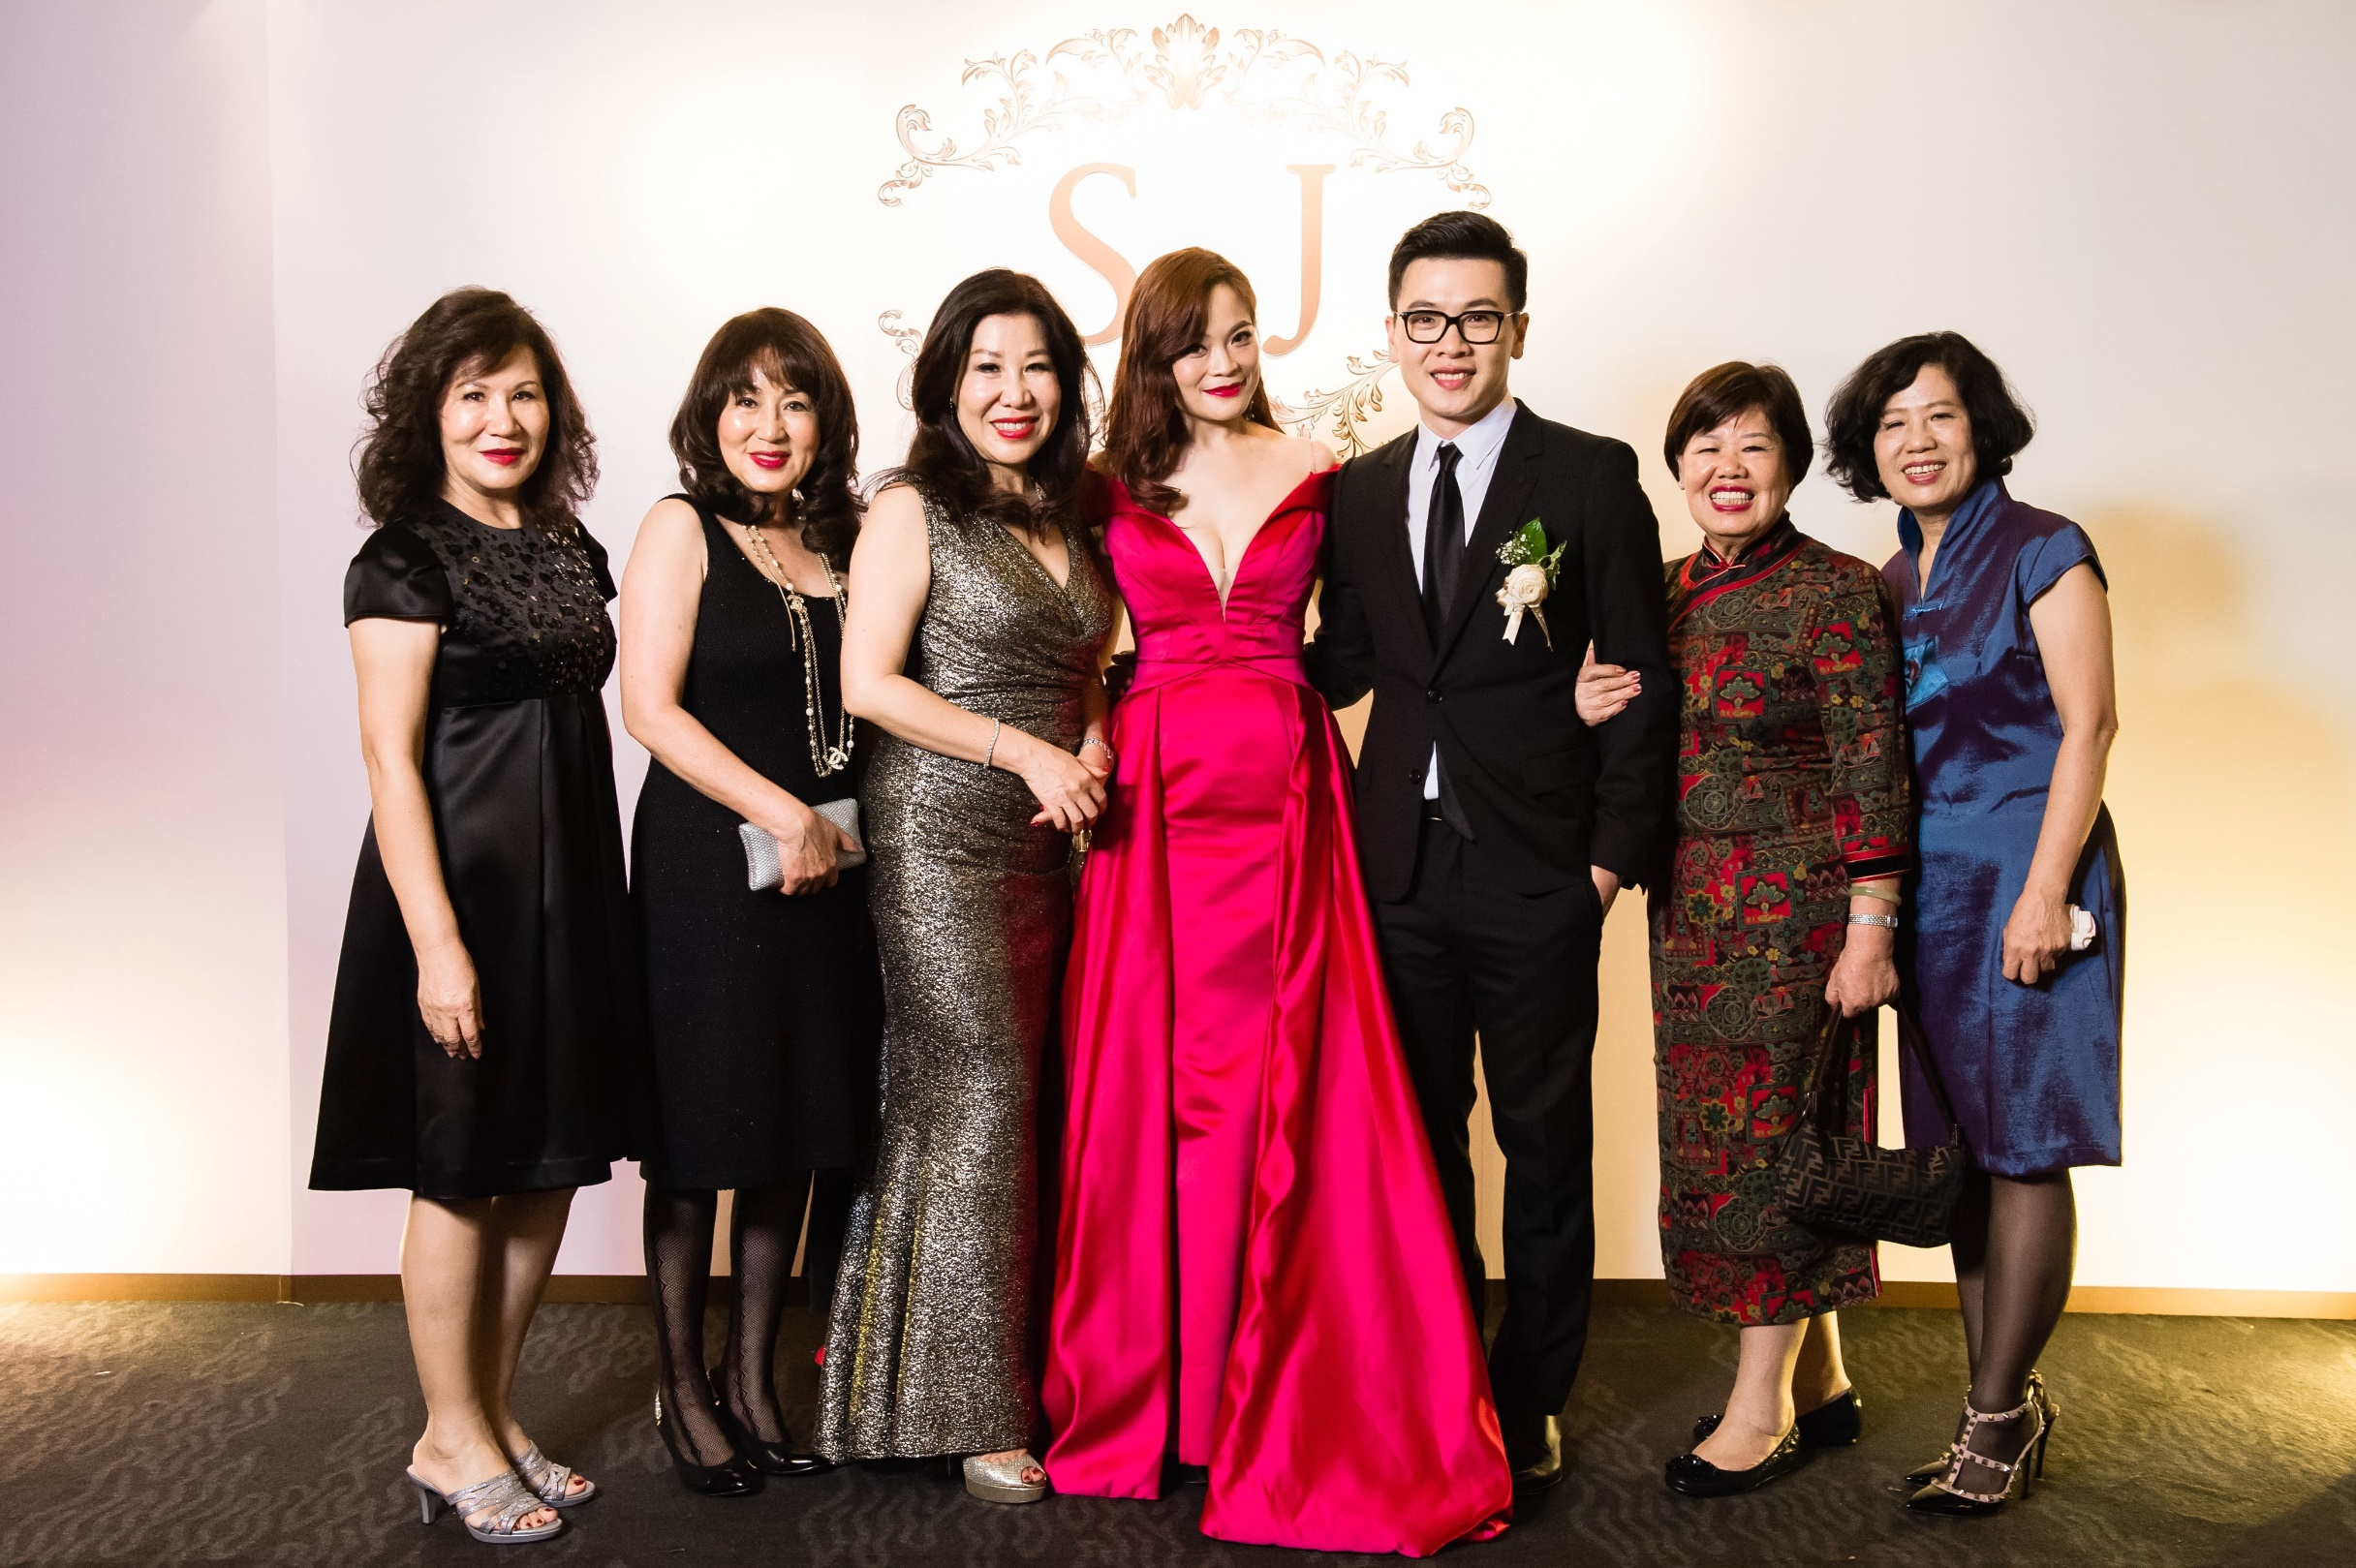

Slide 5
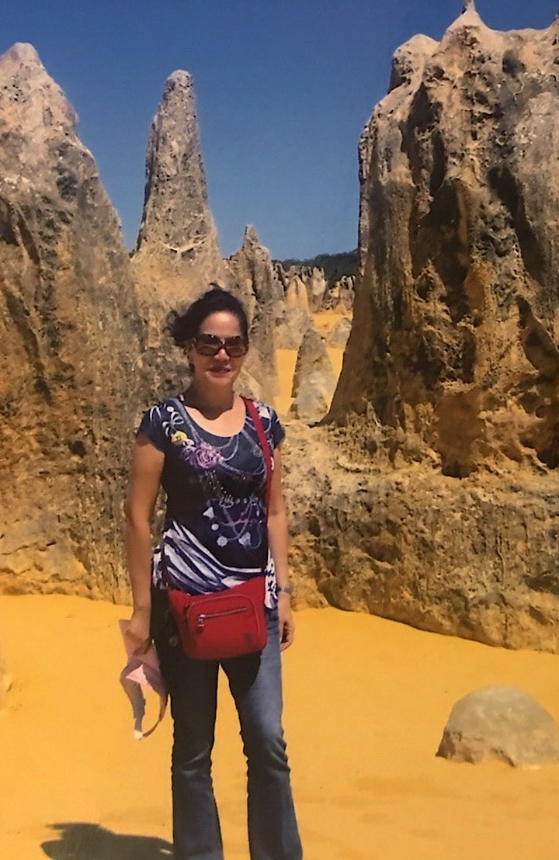
National Supervising Coordinator
four-week pay cycle
US$10,000 - US$15,000
席海南

Slide 6
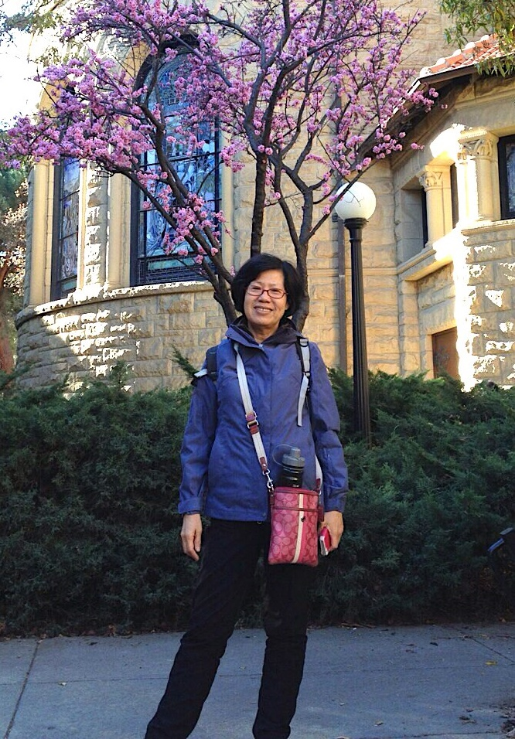
Professional Coordinator
four-week pay cycle
US$4500 – US$7500
席幼凤

Slide 7
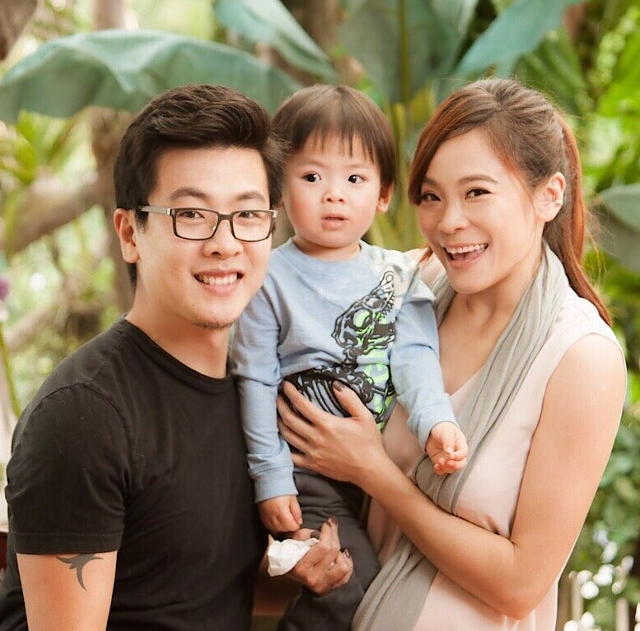
Executive Field
Vice President
four-week pay cycle
US$45,000 – US$63,000
Stacy Tung

Slide 8
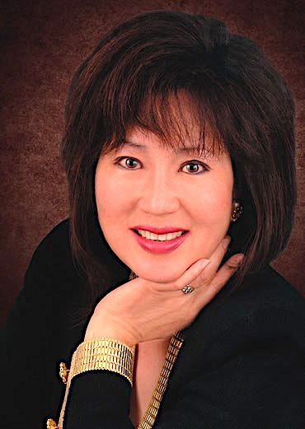
SENIOR EXECUTIVE FIELD VICE PRESIDENT
four-week pay cycle
US$63,000 – US$81,000
Nina Hale (席南怡)
THE INCOME LEVELS MENTIONED IN THIS PRESENTATION ARE FOR ILLUSTRATION PURPOSES ONLY. THEY ARE NOT INTENDED TO REPRESENT THE INCOME OF ANY TYPICAL MARKET SINGAPORE ® UNFRANCHISE® OWNER, NOR ARE THEY INTENDED TO REPRESENT THAT ANY GIVEN UNFRANCHISE® OWNER WILL EARN INCOME IN THAT AMOUNT.
THE SUCCESS OF ANY MARKET SINGAPORE ® UNFRANCHISE® OWNER WILL DEPEND UPON THE AMOUNT OF HARD WORK, TALENT, AND DEDICATION WHICH HE OR SHE DEVOTES TO BUILDING HIS OR HER MARKET SINGAPORE® BUSINESS.

Slide 9
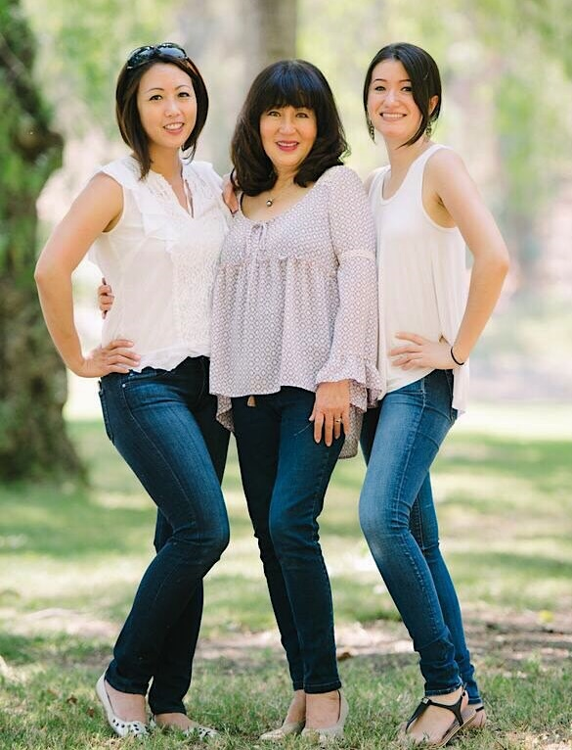

Slide 10
SENIOR EXECUTIVE FIELD VICE PRESIDENT
four-week pay cycle
US$63,000 – US$81,000
Nina Hale (席南怡)

Slide 11
Magic of Residual Income

Slide 12

You need belief
Belief in yourself
Belief in your company
Belief in your team
Belief Is The Foundation Of Everything

Slide 13
Treat Your Business Like Big Business
Market Singapore® combined the Internet, Shop.com, Franchising, Networking, and Wellness/ Health & Nutrition, all the powerful business forms of this century. We lead the parade in the next trillion dollar industry. If you believe you are involved in the biggest and the best business of your life , you will work to make it and get paid accordingly!

Slide 14

Be a product of the product
If you don’t use as many products as you can, then your team won’t either. You can’t recommend products you don’t use right? Become a living example of the quality of your products. It’s easy to retail when people can see your energy and health.

Slide 15

Speak Fluent Market America
Notes:
)

Slide 16

Talk in Themes
Make sure you can easily talk about MASG Themes like: Franchise vs. Unfranchise®, the 2-3 Year Plan vs the 45 year plan, Internet Marketing, the GMTSS, Shopping Annuity® and Shop.com

Slide 17

Social Media Recruiting
Now more than ever, it’s become easier to start a conversation through Social Media. Are you taking advantage of these mediums? Rekindle cold markets by messaging old friends or acquaintances. But remember not to spam! Be yourself, not a pushy salesman.

Slide 18
Learn How To Show The Plan
Learn how to show the plan
You Cannot Conduct a One-on-One or Two-on-One and the ABC Pattern if You Cannot show the Plan

Slide 19
To build market America business you need to understand these
Not everybody will do Market Singapore®
It’s impossible that no one will do Market Singapore®

Slide 20
5 ReasonS to go to Convention
1. Belief and Attitude
2. Knowledge and Duplication
3. Realisation and Insight
4. Fellowship and Fun
5. Leadership by Example and Shortcut to Success

Slide 21
THREE MAJOR CAUSES OF THE PLATEAU EFFECT
1. DEAD BATTERIES
Convention gives everyone new batteries, so they can begin recruiting again. You use the convention to convince new unfranchise® owners and to recruit new prospects.

Slide 22
THREE MAJOR CAUSES OF THE PLATEAU EFFECT
2. NO ABC PATTERN OR THE REVERSE ABC PATTERN
If there was ever an event that would convince and motivate fence sitters to step up and go now, the convention will do it. The key is purchasing tickets in advance and selling them. If you duplicate this process in your group, you’ll have a recruiting explosion. The problem is solved when you discover that you now have new people with whom to work the pattern!

Slide 23
THREE MAJOR CAUSES OF THE PLATEAU EFFECT
YOU STOP SPONSORING AND YOUR GROUP DUPLICATES YOU, SO EVERYONE STOPS SPONSORING.
This is the biggest reason. You plateau, you stop growing. One of the biggest misconceptions in the business is the notion that all you need to do is sponsor two people. You need two people to be activated. You really need to build two sales organisation or two successful legs in order to make six figure income.

Slide 24
Result producing activities
Use and Sell the Products
Share the Business
Share the Shopping Annuity®
Sell Tickets (Education)

Slide 25
Some tips
The Guide and Tips to get you to the top
Create Duplication - Empower your Leaders
Build your Base 10, Seven Strong
Shopping Annuity® Bonus Program
Develop a Warm and Unified Team
If you are always demanding and never giving, always headstrong but never yielding, in the end you will have nothing
Growing Together and building each other up is the key to thriving in Market Singapore®

